Slide 1
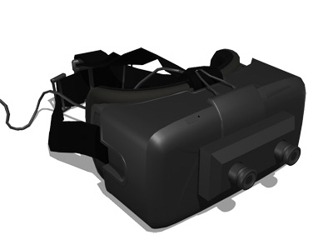
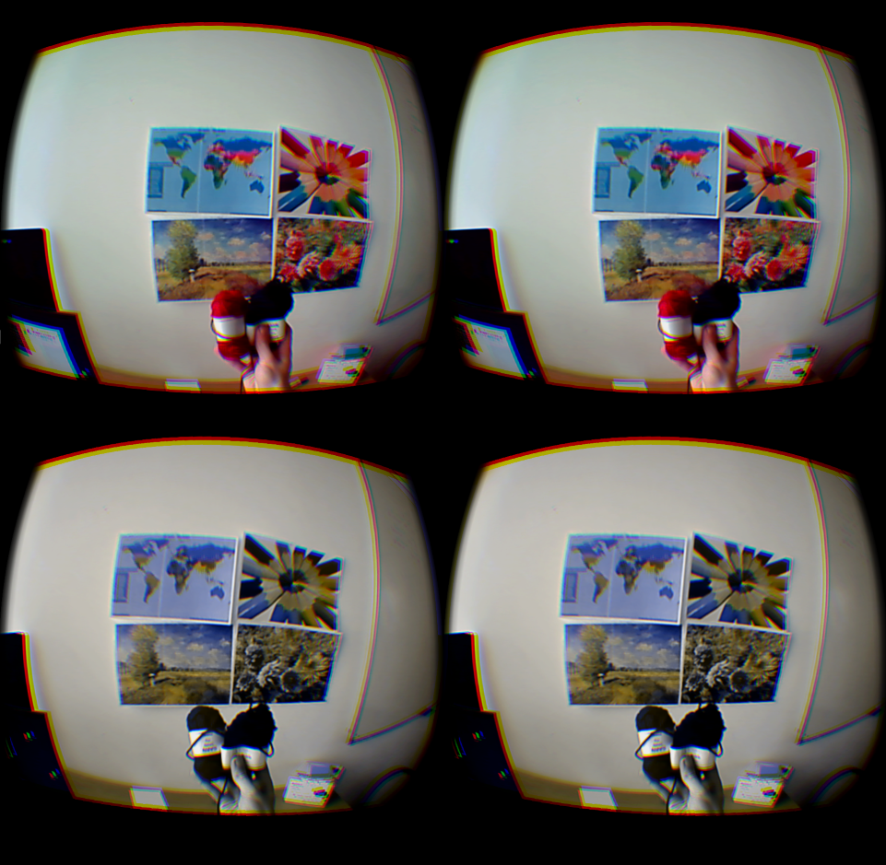
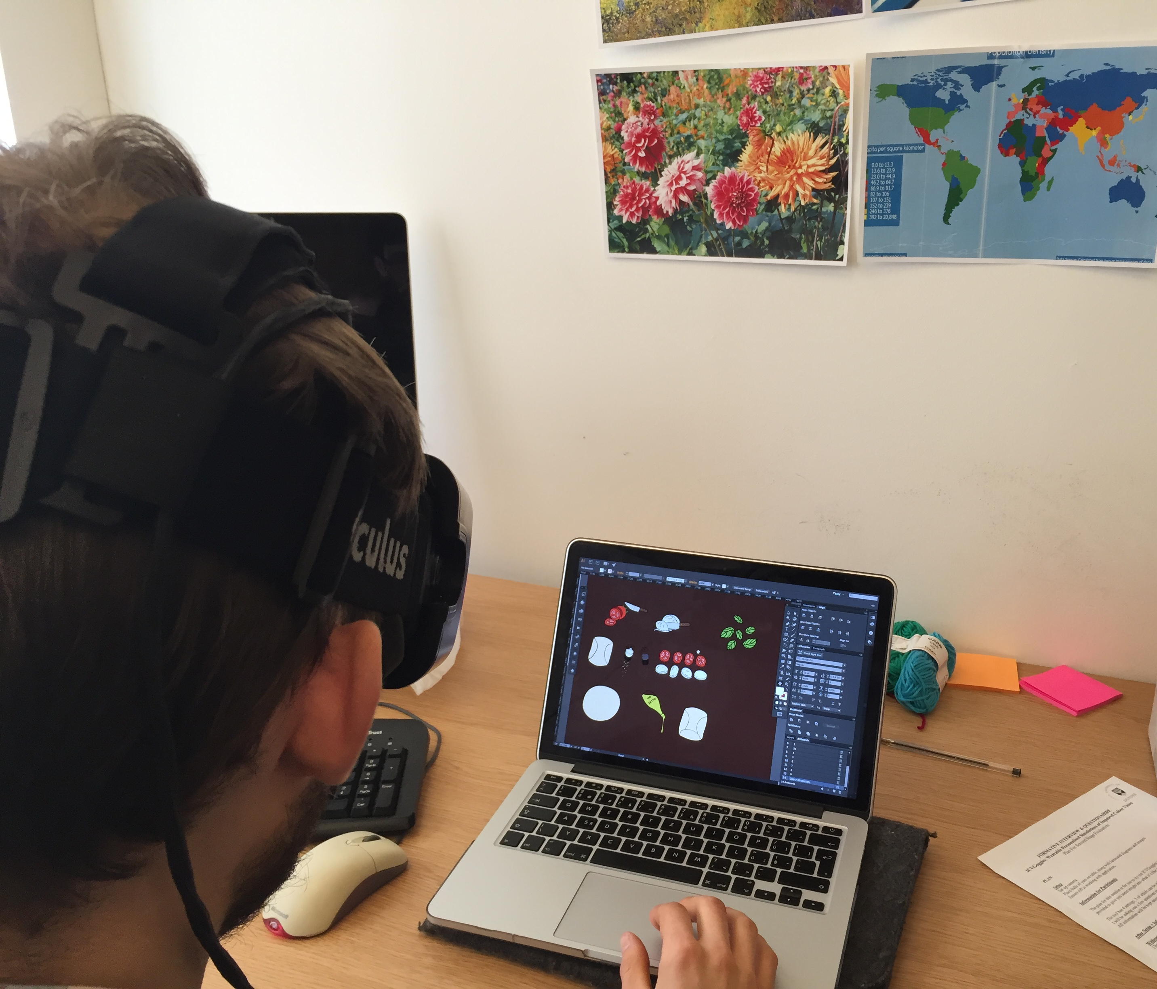
ICVGoggles: Wearable Adjustable Simulations of Impaired Colour Vision
Babak Momen
Supervised by Dr. David Flatla
There are a plethora of impaired colour vision (ICV) simulation tools available, however none can provide a hands-free and adjustable solution.
Figure 1: ICVGoggles uses the Oculus Rift DK2 and OVRVision cameras.
ICVGoggles can simulate four types of ICV: Protanopia, Deuteranopia, Tritanopia and Monochromacy. By adjusting the severity, the world around you will gradually lose or gain colours in real-time.
Two user studies took place with designers from DJCAD and the University of Dundee to evaluate the effects of using ICVGoggles.
Figure 2: Normal colour vision top, Protanopia on max severity bottom.
Participants found ICVGoggles both helpful and informative. The system was used to learn more about ICV by some, others used it to check colour choices in their own work.
ICVGoggles can be applied in design practices and teaching environments.
Figure 3: ICVGoggles being used to colour check work.

